Slide 1
Software Construction and Development
Week 11
Instructor :M Khizar Hayat
Version Control Systems

Slide 2
Introduction to Version Control Systems
Version Control System (VCS) is a tool that records changes to files over time.
It allows developers to track modifications in source code.
Helps in reverting back to previous working versions when needed.
Essential for both small and large software projects.

Slide 3
Importance of Version Control
Keeps complete history of project changes
Prevents accidental loss of code
Enables teamwork on same project
Helps in debugging and identifying issues
Improves software quality and reliability

Slide 4
Types of VCS
Centralized Version Control System (CVCS):
In CVCS, there is a single central server that stores all versions of the code. Developers must connect to this server to access or update files.
Example: SVN (Subversion)
Distributed Version Control System (DVCS):
In DVCS, every developer has a full copy of the entire repository, including its history. Work can continue even without the main server.
Example: Git

Slide 5
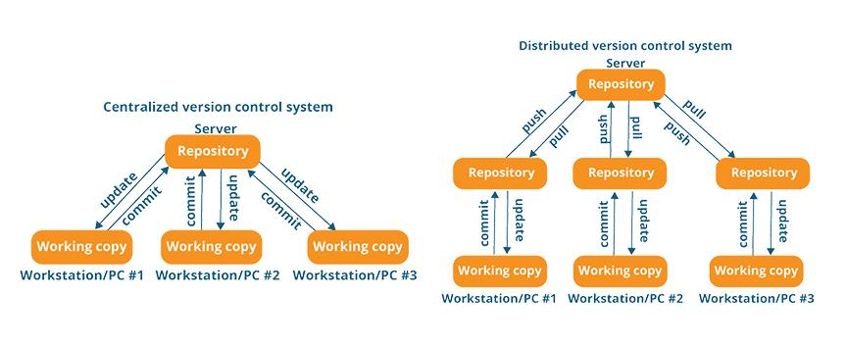

Slide 6
Introduction to Git
Git is a distributed Version Control System (VCS).
It was created by Linus Torvalds in 2005.
In Git, every developer has a complete copy of the repository and its history on their local system.
Developers can work offline and sync changes later when internet is available.
Git is fast, efficient, and suitable for handling large software projects.

Slide 7
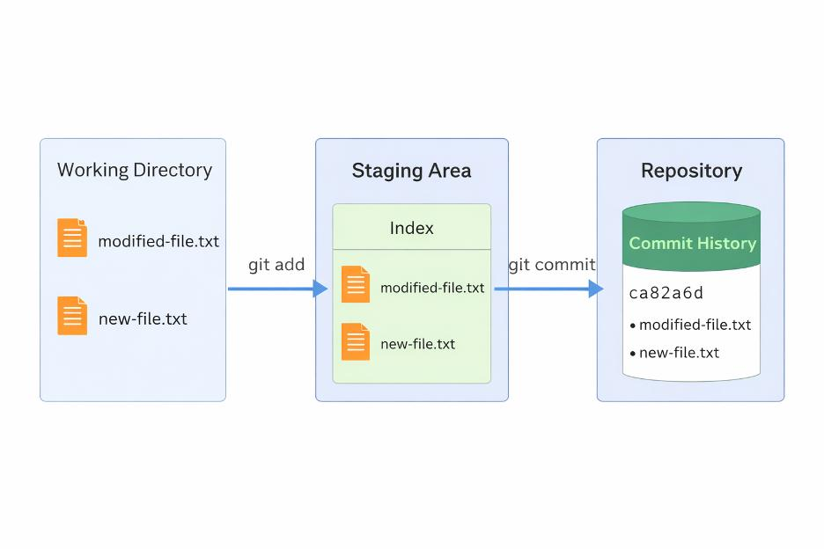
Git Architecture

Slide 8
Working Directory: Area where developers create and edit files
Staging Area: Temporary area where selected changes are prepared before commit
Repository: Stores committed changes permanently with complete history
Git architecture helps separate unfinished work from finalized code changes.

Slide 9
Basic Git Commands
git init: Create new repository
git add: Add files to staging area
git commit: Save snapshot of changes
git status: Check current state of files
git log: View commit history
git push: Upload changes to remote repository
git pull: Download latest changes from remote repository

Slide 10
Remote Repositories
GitHub is an online platform used to host Git repositories and manage software projects
GitLab is a platform that provides Git repository hosting along with DevOps and CI/CD tools
Remote repositories allow developers to collaborate from different locations.
Developers can easily push and pull code changes between local and remote repositories.

Slide 11
Cloning and Forking
Clone: Copy a repository from GitHub/GitLab to your computer so you can work on it locally.
Fork: Create your own copy of someone else’s repository on GitHub/GitLab.
Cloning is mainly used when working on a project as a team member.
Forking is commonly used in open-source projects to make changes without affecting the original project.

Slide 12
Branching in Git
Branching allows multiple lines of development
Main branch contains stable production code
Feature branches are created for new features
Developers work independently without affecting main code

Slide 13
Main Types of Branches in Git
Main Branch (master/main):
Contains the stable and final version of the project.
Development (Dev) Branch:
Used for ongoing development and integration of features before merging into main.
Feature Branch:
Used for developing new features separately.
Bugfix Branch:
Used to fix errors or bugs in the project.
Release Branch:
Prepared when the software is ready for testing and deployment.
Hotfix Branch:
Used to quickly fix urgent issues in the live application.

Slide 14
Merging in Git
Merging in Git is the process of combining changes from one branch into another branch (usually into the main branch)
It is used to integrate completed features, bug fixes, or updates into a single project
After merging, both branches changes become part of one unified codebase
Merging is commonly done after a Pull Request is reviewed and approved

Slide 15
Core Merge Types
Fast-Forward Merge: Occurs when there is a direct linear path between branches; Git simply moves the branch pointer forward without creating a new commit
Three-Way (Recursive) Merge: Used when branches have diverged; Git finds a common base commit and creates a new merge commit combining both branches
Merge Strategies (Used in GitHub/GitLab Tools)
Squash and Merge: Combines all commits from a feature branch into a single commit before merging for a clean history.
Rebase and Merge: Re-applies commits on top of another branch to maintain a linear project history.

Slide 16
Merge Conflicts
Occur when same file is modified in different branches
Git cannot automatically decide which change to keep
Developers must manually resolve conflicts
Conflict markers show differences in code

Slide 17
Pull Requests
A Pull Request (PR) is a request to merge code from one branch into the main branch.
It allows team members to discuss, review, and approve changes before merging
It helps improve code quality by identifying bugs and suggesting improvements
It supports collaboration among multiple developers working on the same project
PRs are commonly used in platforms like GitHub and GitLab.

Slide 18
Code Review in PR
Team members review code changes
Check for bugs and improvements
Ensure coding standards are followed
Helps maintain clean and efficient codebase

Slide 19
Collaborative Workflow
Developers start by cloning the repository from a remote platform
Each developer creates a separate branch for their task or feature
Code is written, tested, and changes are saved using commits
Changes are sent to the remote repository using push
A Pull Request (PR) is created to propose merging changes
Team members perform code review and give feedback
After approval, changes are merged into the main branch
This workflow ensures safe teamwork, better code quality, and organized development

Slide 20
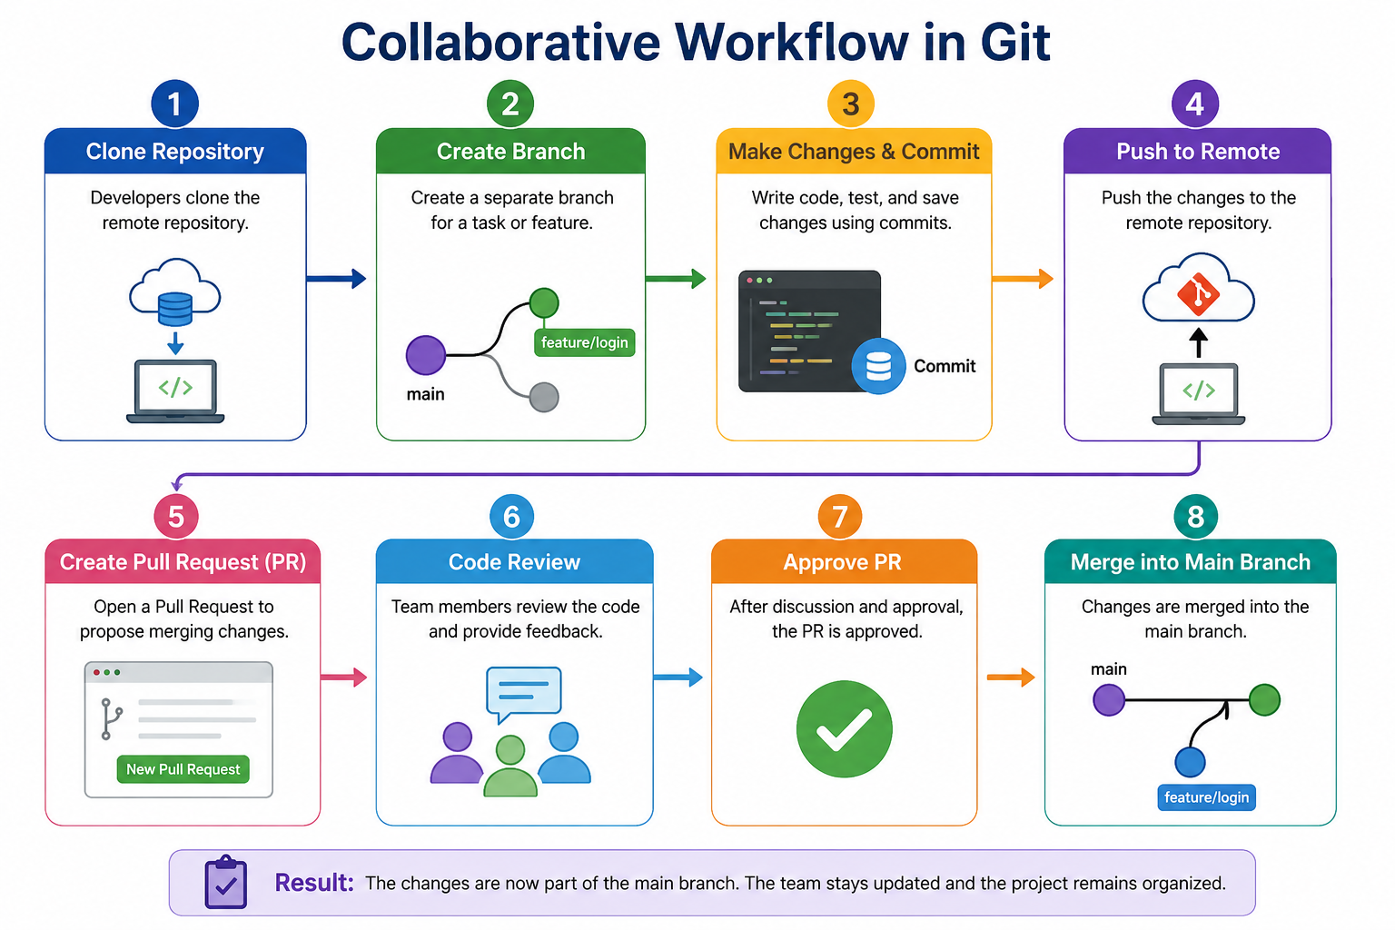

Slide 21
GitHub Features
Issue tracking for bug reporting
Pull requests for collaboration
GitHub Actions for automation and CI/CD
Repository hosting for open-source projects

Slide 22
CI/CD (Continuous Integration & Continuous Delivery or Deployment)
CI (Continuous Integration):
Developers frequently push code to a shared repository where it is automatically built and tested
CD (Continuous Deployment/Delivery):
Tested code is automatically or manually deployed to staging or production servers

Slide 23
GitHub CI/CD Features
Automated build and testing using GitHub Actions
Continuous Integration of code changes
Automated deployment to staging and production
Code quality checks on every push
Monitoring and feedback through logs and alerts

Slide 24
Best Practices & Conclusion
Commit code frequently with clear messages
Use branches for separate features
Always review code before merging
Avoid working directly on main branch
Version control is essential for modern software engineering

Slide 25
Thank You!

